Slide 1
OOP Pharmacy Project.
A helpful project for easy handling pharmacy stuff!.

Slide 2
OOP Pharmacy Project.
The Project Members are :
Mohamed Shawky Ahmed Mohamed Sec: 10 .
Mazen Sabry Hammam Sec: 9.
Mohamed Adel Zaki Elbaal Sec: 11.
Mohamed Khaled Elsayed Mohamed Sec:10.
Amira Ahmed Mostafa Ghanem Sec:4.
Mohamed Abdel Nasser Mohamed Abdou Sec:11.

Slide 3

Our project is simply helpful for handling pharmacy stuff!

Slide 4
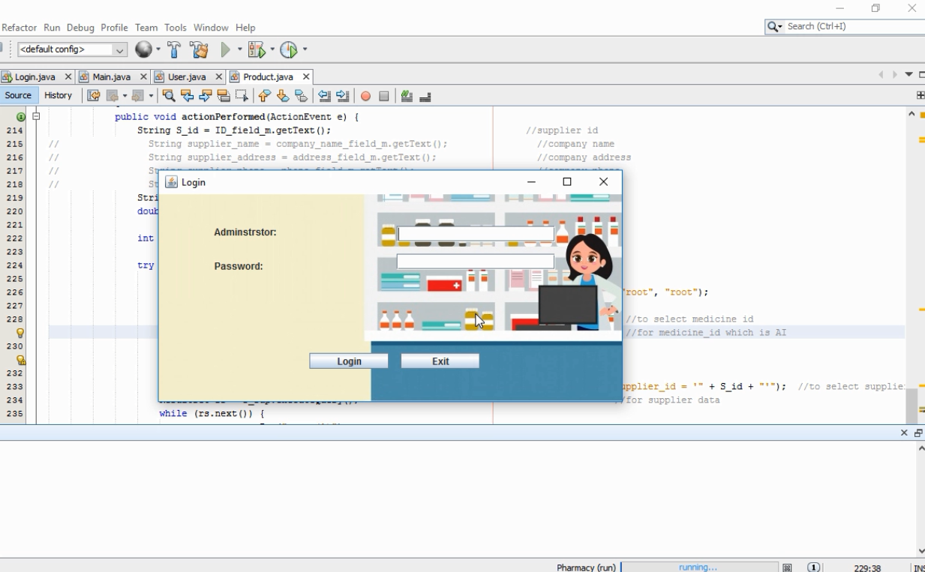
This is our Login form for the administrator.

Slide 5
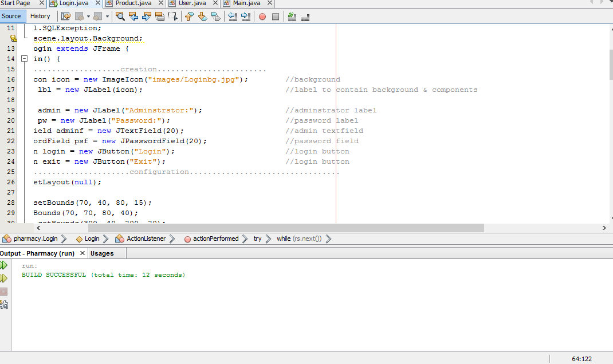
This is our code of Login Form.

Slide 6
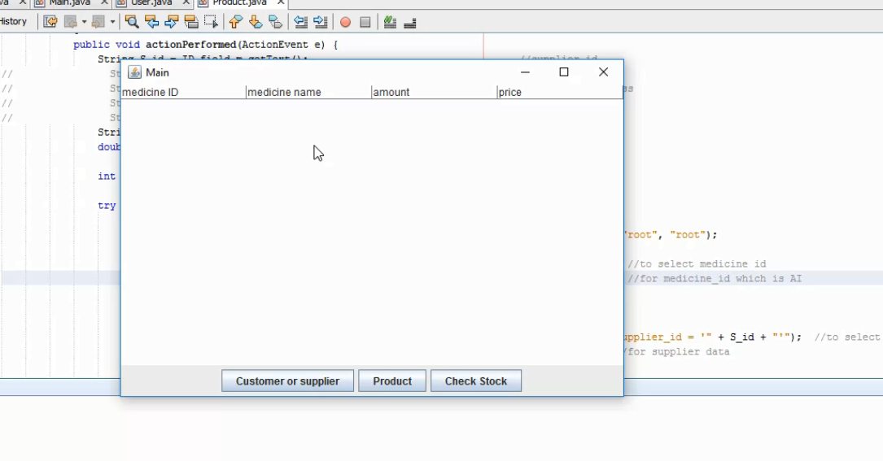
Our Main Form with 3 basics button for managing the project.

Slide 7
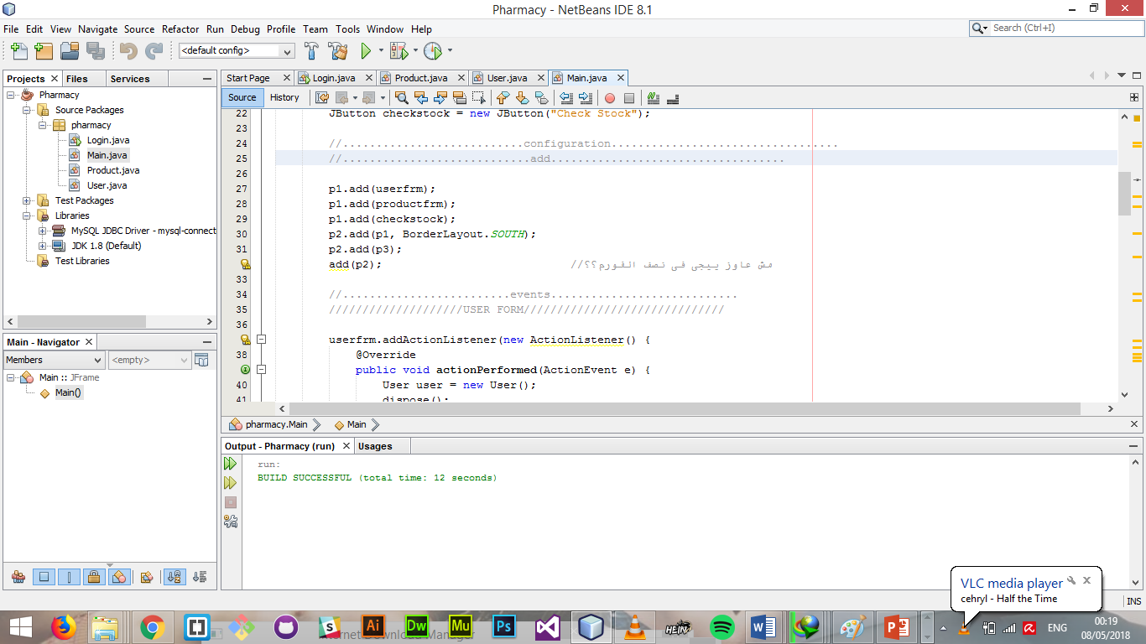
The Main form code is here.

Slide 8
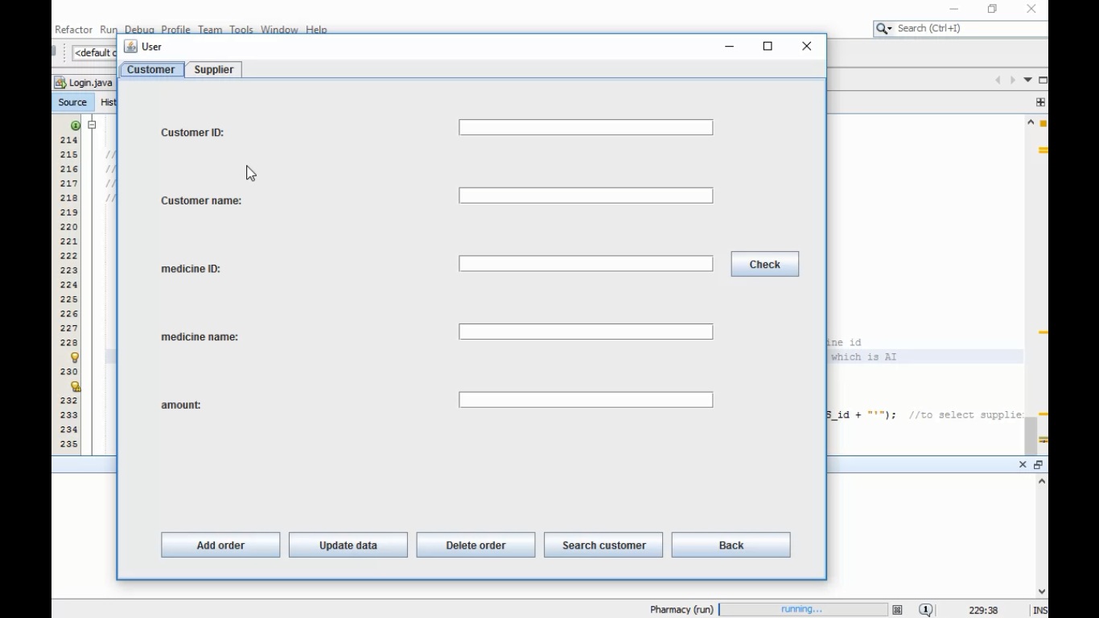
This is our Customer form .

Slide 9
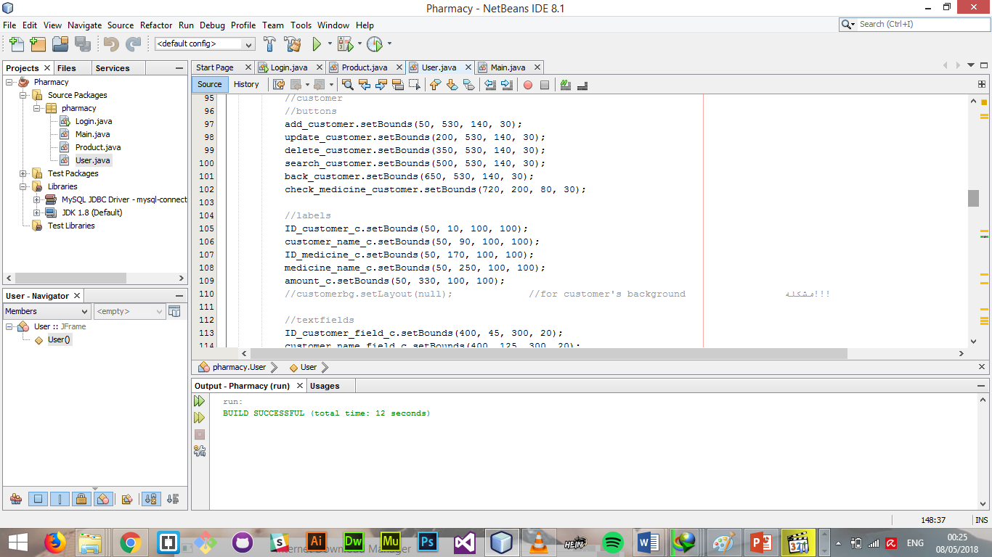
The customer form code is here.

Slide 10
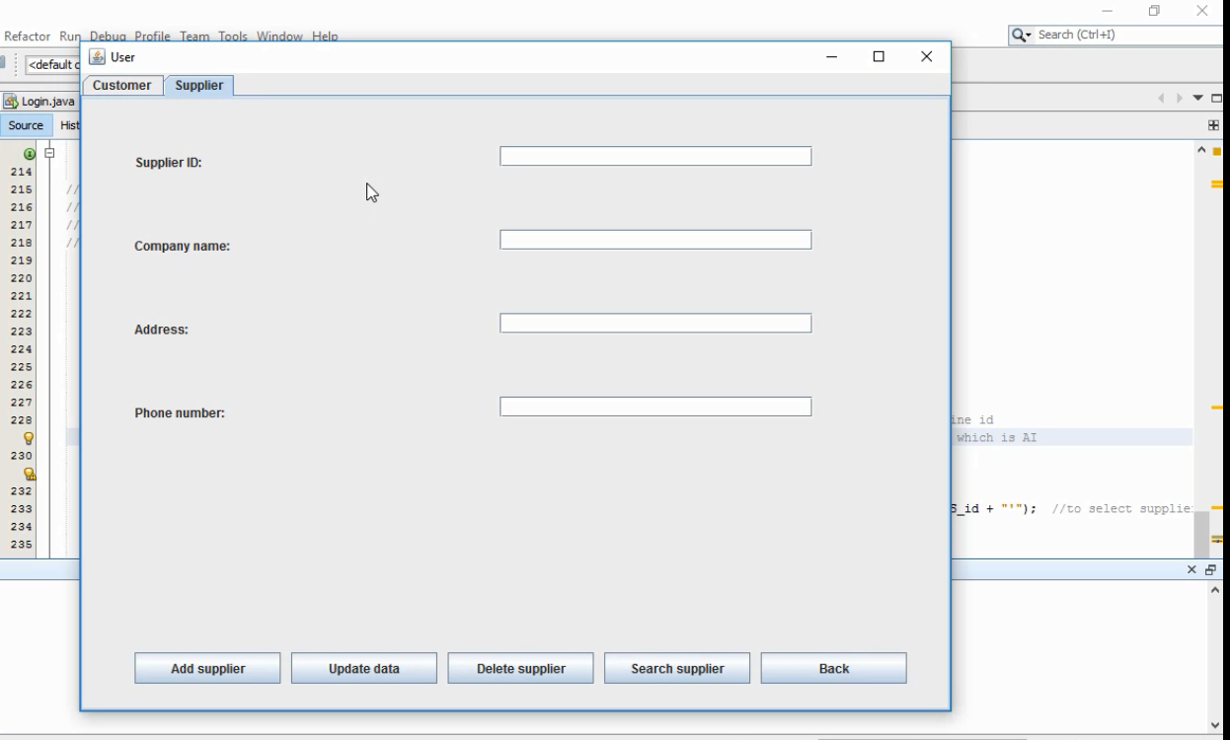
This is our Supplier form.

Slide 11
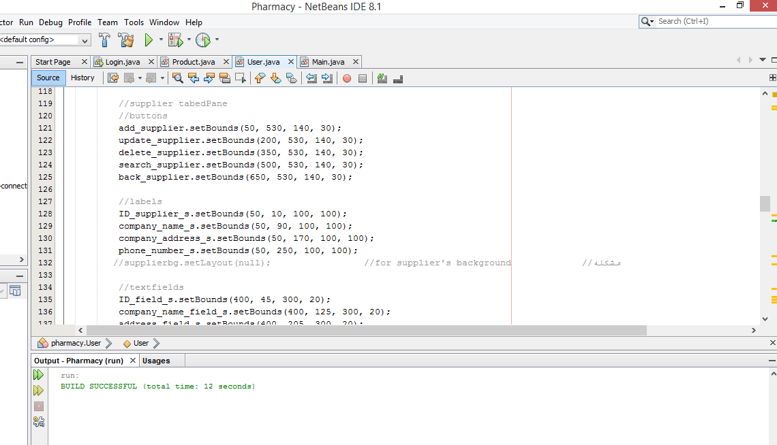
The supplier form code is here.

Slide 12
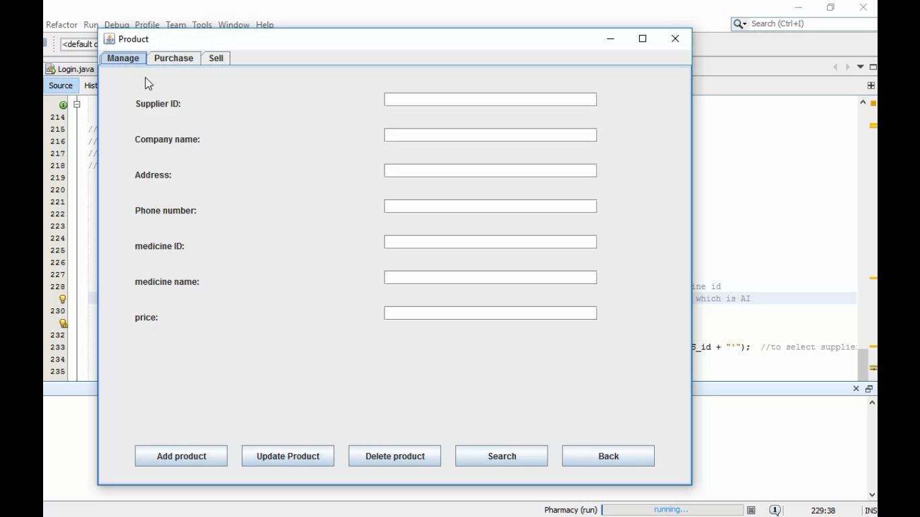
The product form. (ManageArea)

Slide 13
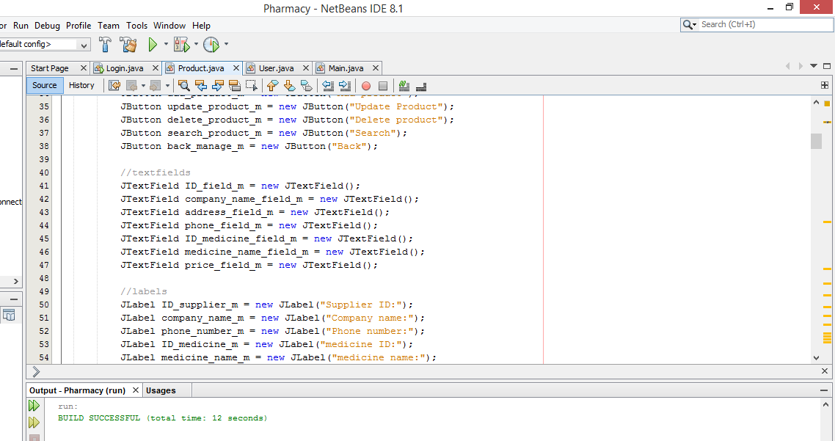
Some of Product Code (Manage).

Slide 14
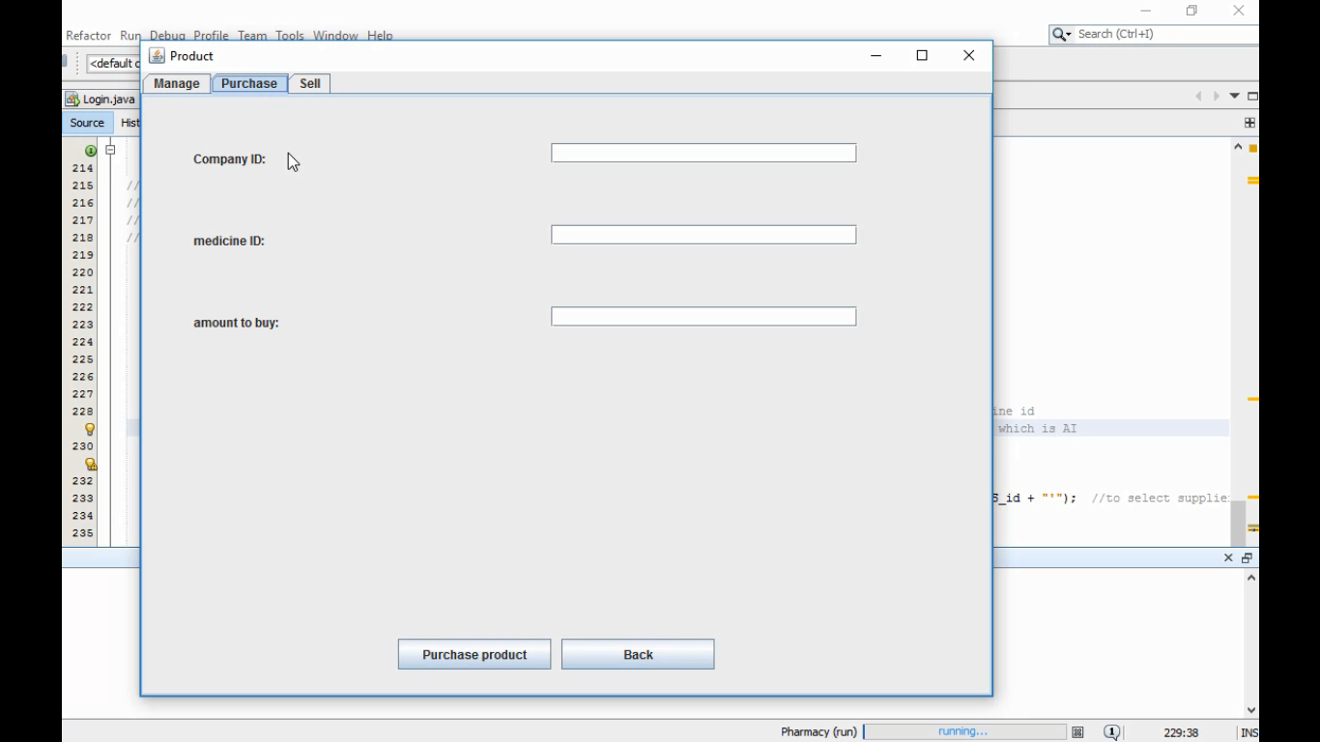
The product form. (PurchaseArea)

Slide 15
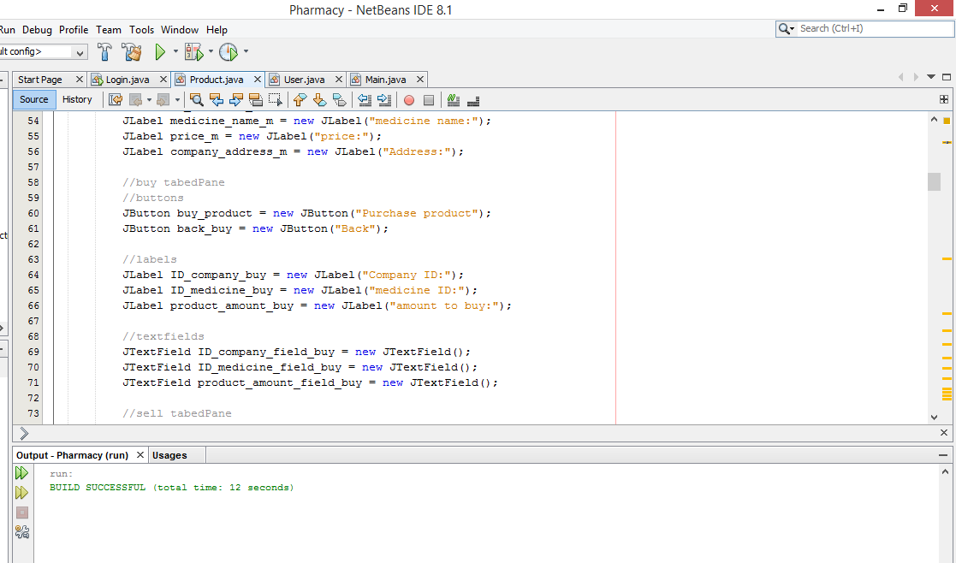
Some of Product Code (Purchase).

Slide 16
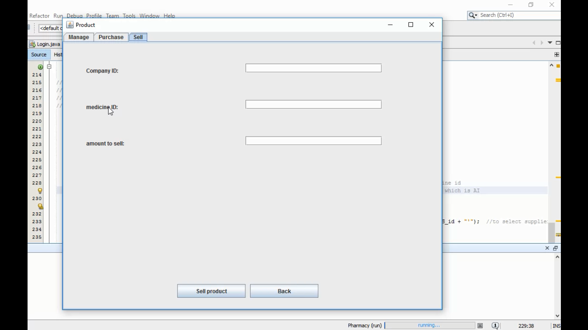
The product form. (Sell Area)

Slide 17
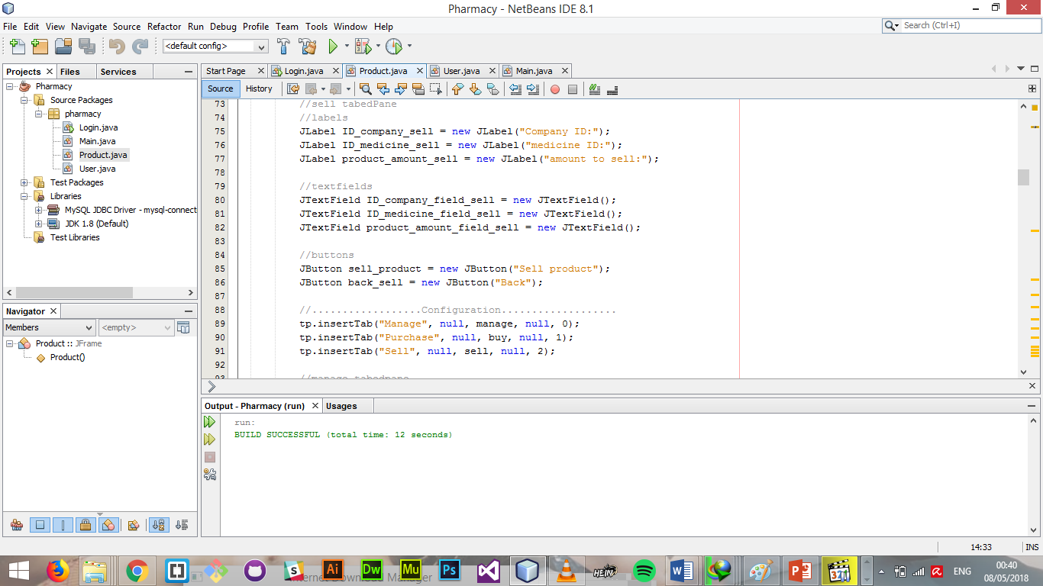
Some of Product Code (Sell).

Slide 18
We are done.
Thanks for your attention.

